Slide 1


MOTOR VEHICLE COLLISIONS(Vision Zero)
CAPSTONE PROJECT
LaGuardia Community College
DC 37 Data Analytics Cohort 1
Presented by: Lakshmi P Kadissery
PROFESSor: Imran Khan

Slide 2

Research Questions
Which Borough has the highest Collisions?
Which vehicle type occurred more frequently?
The impact of Vision Zero on the average number of collisions per year in Brooklyn

Slide 3
Background
In 2025 there was over 47,000 vehicle related injuries
Almost 7% lower than 2024 according to Queens Chronical
Thanks partially due to the Vision Zero incentive
To analyze motor vehicle collisions

Slide 4
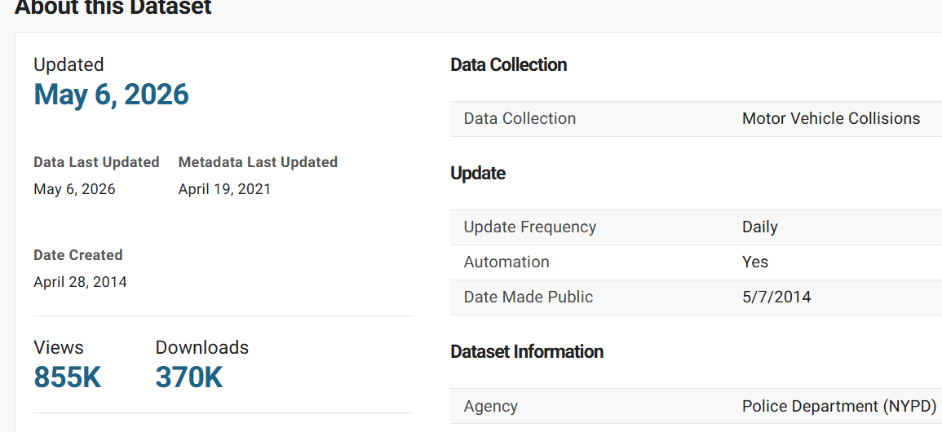
Data Source
NYC Open Data/Motor Vehicle Collisions-Crashes
Motor Vehicle Collisions - Crashes | NYC Open Data

Slide 5
Methodology
Downloaded 100k rows of the data through colab
Reviewed the data in detail to determine the rows and columns to keep for my analysis
Cleaned data to exclude missing/null values, made subsets using proper syntaxes
Calculated the total number of collisions that occurred in each borough
Calculated most frequent vehicle types involved in collisions across all boroughs
Created Bar charts to visualize the analysis

Slide 6
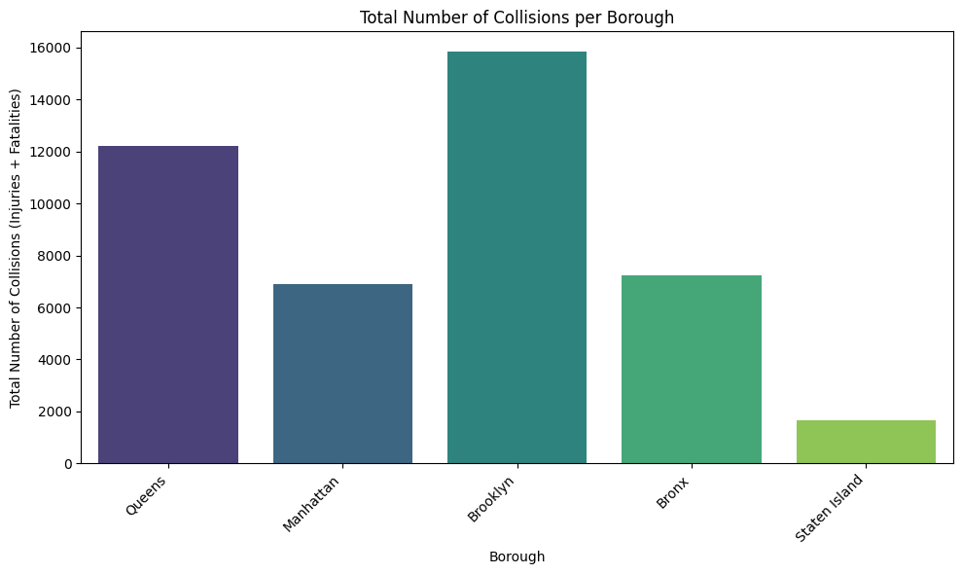
Findings
Brooklyn has most number of collisions
Staten Island has least number of collisions

Slide 7
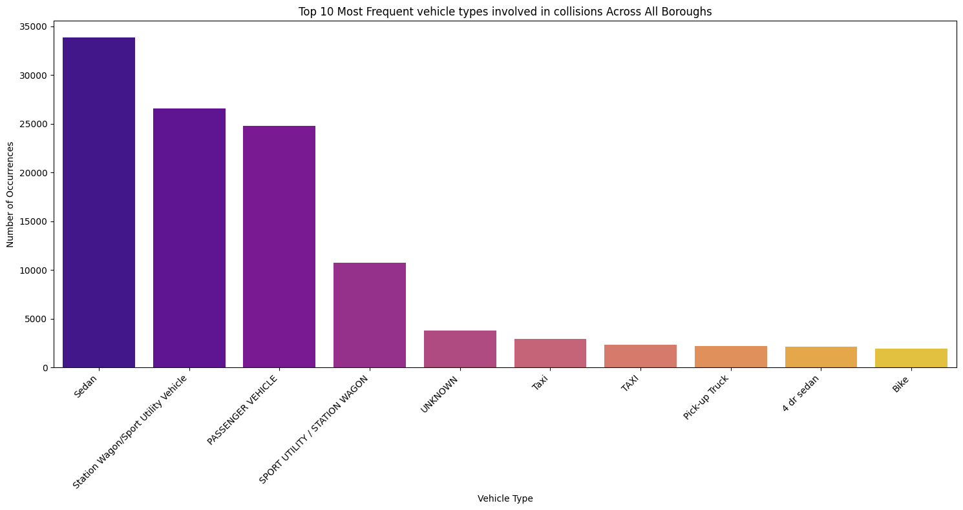
Findings
Across all the boroughs, most collisions involved sedans.

Slide 8
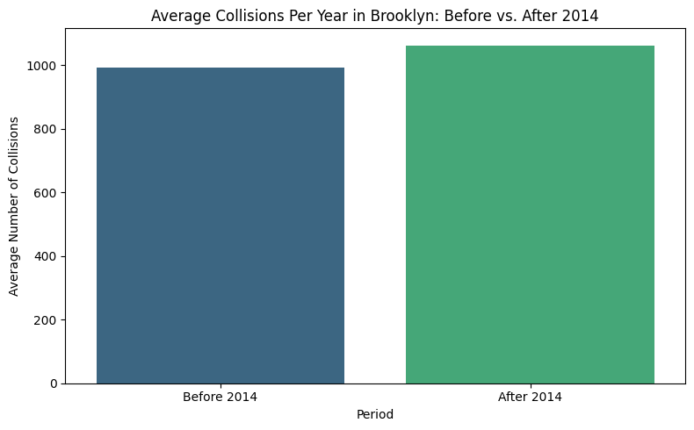
Findings
Less datapoints before 2014
Graph doesn’t match expected conclusion and actual data from news articles

Slide 9
Conclusions and future outlook
Most collisions occurred in Brooklyn between 2012 and 2026
Sedans were involved in majority of collisions
Correlation between number of collisions and Vision Zero initiative

Slide 10
References
Motor Vehicle Collisions - Crashes | NYC Open Data
https://www.nyc.gov/html/dot/html/pr2025/decline-in-traffic-deaths.shtml

